Slide 1
Bar Graph Sorting with Animation Microtutorial
Ben Garland
March 23, 2026
Web Mapping

Slide 2
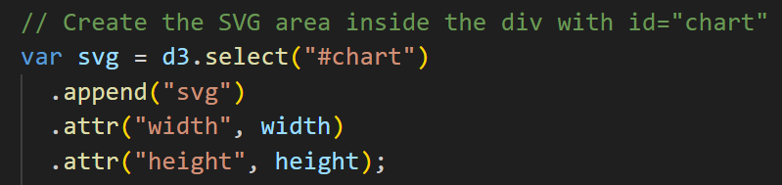
Step 1: Create SVG
Creates an SVG element inside the page
This is where all graphics will be drawn
This sets up the drawing area, but nothing is visible yet except a border.

Slide 3
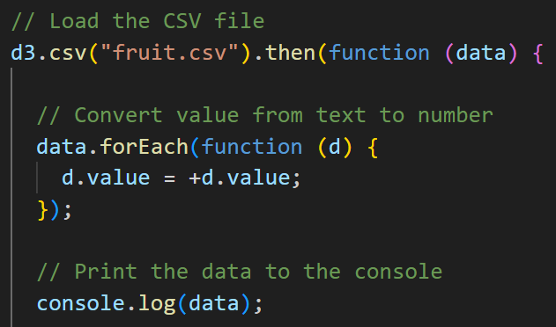
Step 2: Load CSV Data
Loads external CSV file
Converts values to numbers
Prints data to the console to check it worked
This loads the data file and prepares it so we can use it in the chart.

Slide 4
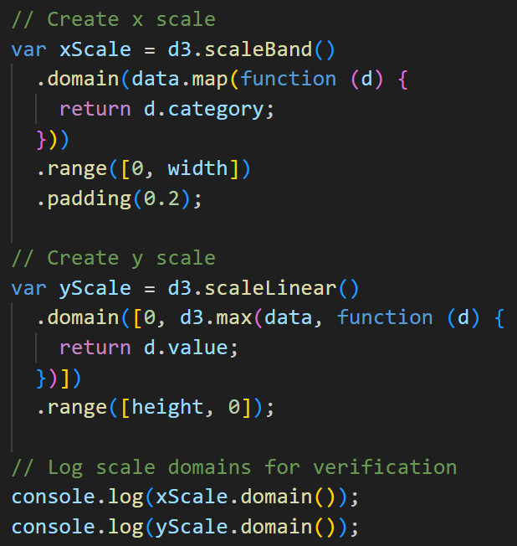
Step 3: Scales
X scale → positions categories along bottom
Y scale → controls bar height
Scales turn our data into positions and sizes on the screen.

Slide 5
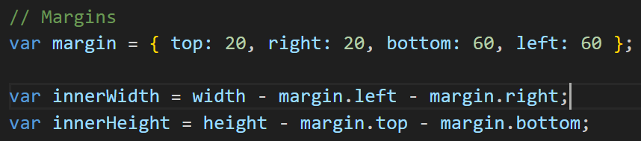
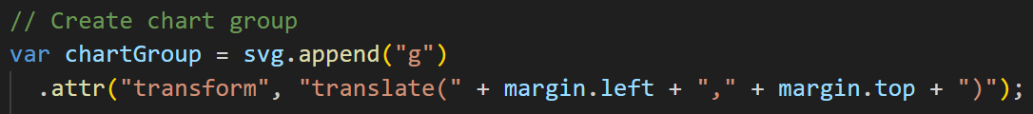
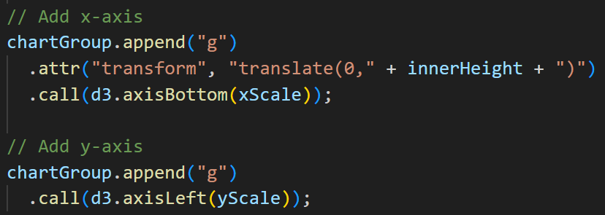
Step 4: Margins + Axes
Margins create space so labels are not cut off
The chart group shifts everything into that space
Axes show the values on the chart
We add margins so the axes fit, then draw the axes using the scales.

Slide 6
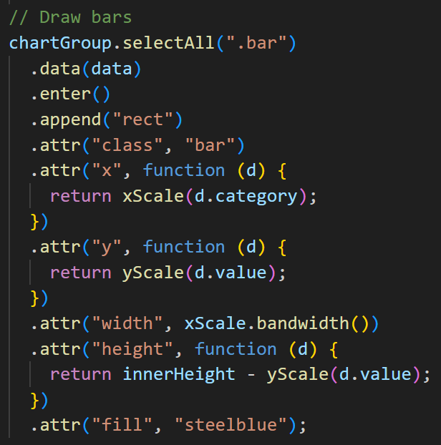
Step 5: Bars
Each data item becomes a rectangle
Position and size come from the scales
Each row of data becomes a bar, and the scales decide where it goes and how tall it is. D3 connects data to shapes on the screen.

Slide 7
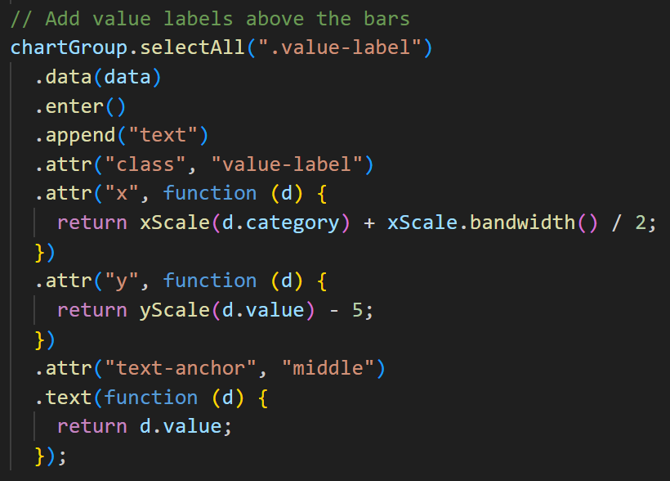
Step 6: Labels
Adds numbers above each bar
Uses the same positioning as the bars
The labels stay aligned because they use the same positioning as the bars.

Slide 8
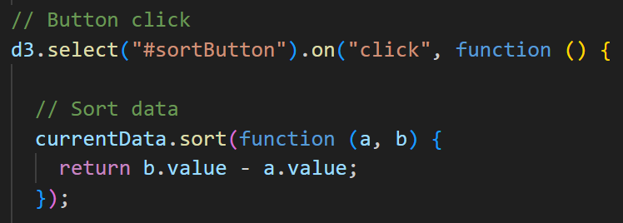
Step 7: Interaction (Sort Button)
Adds a button click event
Reorders the data when clicked
When the button is clicked, the data is sorted and the chart updates.

Slide 9
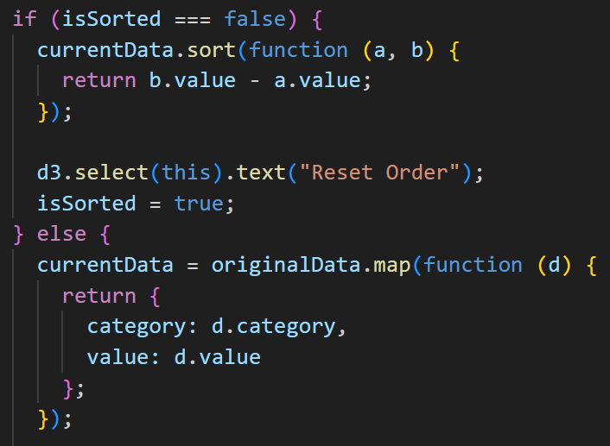
Step 8: Toggle State
Keeps track of current state (sorted or original)
Switches between the two
This lets the button switch back and forth instead of only sorting once.

Slide 10
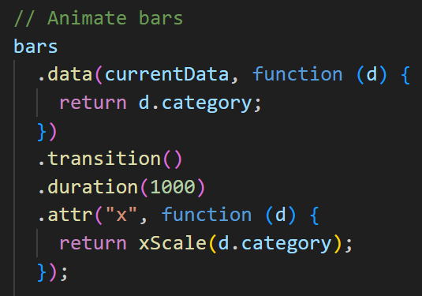
Step 9: Animation (Final)
Smoothly moves bars when data changes
Makes changes easier to see
Animation helps you see how the data changes instead of jumping instantly.

